Slide 1
An Interactive Literature Review on Adaptive Traffic Signal with Real-Time Feedback
Guide: Dr. Shobhana NV
Team Members
Anuvind Krishna
Jalumedi Shashank Babu
Kamal Johnson
George Thomas

Slide 2
Problem Statement
There is very little solutions implemented with machine learning which analysis data from the complete transport grid for achieving overall traffic reduction, this technology exploits the real-time traffic monitoring services which are available nowadays.

Slide 3
Introduction
Traffic congestion has been one of the major issues that most metropolises are facing in spite of measures being taken to mitigate and reduce it.
It will also provide significant data which will help in future road planning and analysis. In further stages multiple traffic lights can be synchronized with each other with an aim of even less traffic congestion and free flow of traffic.

Slide 4
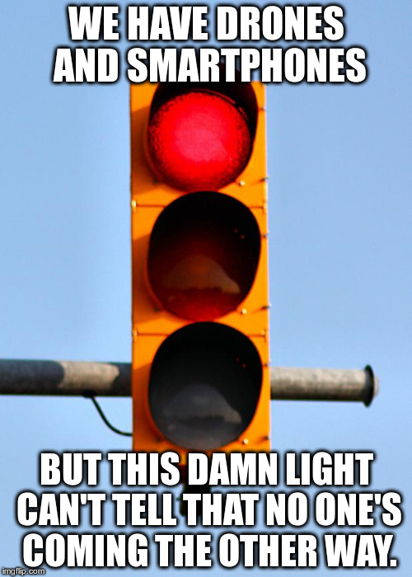

Slide 5
Case Study
Study 1: Haimeng Zhao, Xifeng Zheng, Weiya Liu presented a design of intelligent traffic control system based on DSP and Nios II. (2009)
Their model of intelligent traffic control system deploys dual-CPU combined with the logic control of FPGA (Field Programmable Gate Array)
In order to achieve vehicular congestion it is different from the conventional traffic signal controller in way that it works mostly at the mode of timing and multiple phases according to the user demands dynamically.

Slide 6
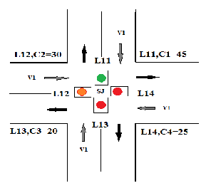
Study 1: Haimeng Zhao, Xifeng Zheng, Weiya Liu presented a design of intelligent traffic control system based on DSP and Nios II. (2009)

Slide 7
Study 1: Haimeng Zhao, Xifeng Zheng, Weiya Liu presented a design of intelligent traffic control system based on DSP and Nios II. (2009)
Intelligent Traffic Control System based on the DSP and Nios II is designed and realized, the function of which is powerful as well as resources of phase and interfaces are quite rich. The system can generate up to more than 160 kinds of phases.

Slide 8
Study 2: Badura, S., & Lieskovsky, A. Intelligent Traffic System: Cooperation of MANET and Image Processing (2010)
New model for intelligent traffic systems which will encapsulate the features of surveillance via the cameras present on the junction and with the help of data delivery systems let the users access that data.
Image Analysis and foreground/background modeling schemes would be the important elements of Surveillance and data transmission over a mobile Ad-hoc network will comprise the data delivery part of the entire system. Various experiments have been conducted in the project and they exhibit great potential in terms of efficiency and real time execution

Slide 9
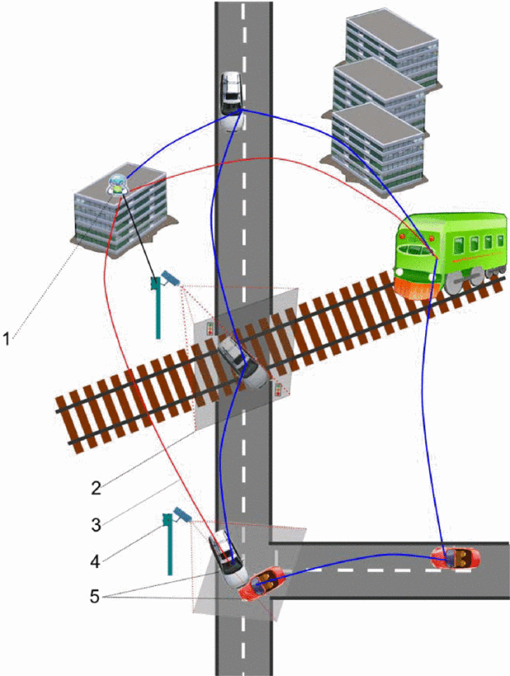
Study 2: Badura, S., & Lieskovsky, A. Intelligent Traffic System: Cooperation of MANET and Image Processing (2010)

Slide 10
Study 2: Badura, S., & Lieskovsky, A. Intelligent Traffic System: Cooperation of MANET and Image Processing (2010)
Salama A.S., Saleh B.K. and Eassa M.M. provide a design of an integrated intelligent system for management and controlling traffic lights with the help of Photoelectric Sensors.
The system uses real-time traffic knowledge to control the traffic lights also provides support for pedestrian crossing and emergency vehicle passing

Slide 11
Study 3: Khekare, G.S., Sakhare A.V. proposed VANETs (Vehicular Ad Hoc Networks) (2013)
VANETs provides communication between vehicles themselves and between vehicles and road side units, which can be integrated for creating a smart city.
Continuous broadcasting is done whether any vehicle is in range or not communication is established or not.

Slide 12
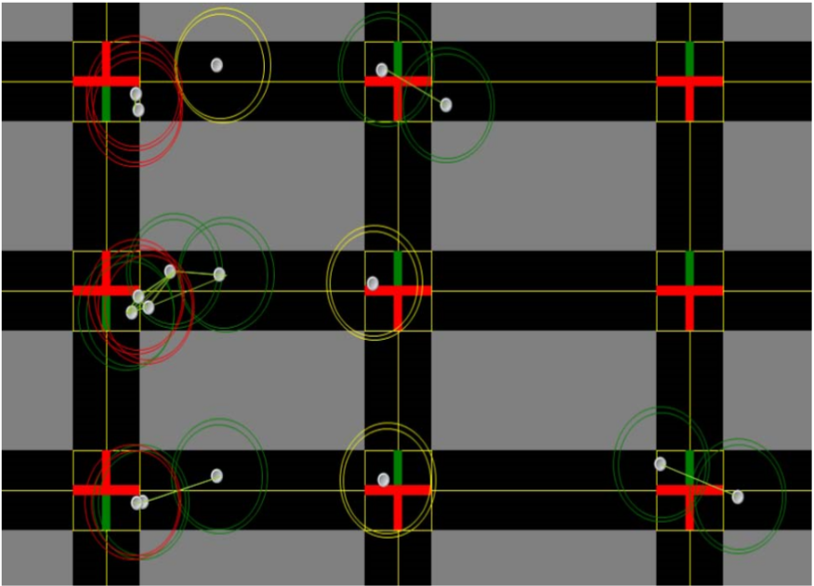
Study 3: Khekare, G.S., Sakhare A.V. proposed VANETs (Vehicular Ad Hoc Networks) (2013)

Slide 13
Study 3: Khekare, G.S., Sakhare A.V. proposed VANETs (Vehicular Ad Hoc Networks) (2013)
Warning message module then sends the data to the traffic density calculation module. Then calculations are made in this module and traffic density of each road is calculated.
This framework of a smart city that will transmit information about traffic conditions and will go a long way in aiding drivers to take spontaneous and smart decisions to prevent themselves from vehicular congestion which will ultimately help in reducing the overall congestion.

Slide 14
Study 4: Kanungo, A., Sharma, A., & Singla, C. proposed Smart traffic lights switching and traffic density calculation using video processing (2014)
Cameras would be capturing video and broadcasting it to the servers where using video and image processing techniques the vehicle density on every side of the road is calculated and an algorithm is employed to switch the traffic lights accordingly.
Peak Time: Density is very high on the roads majorly because of the commuters and as stated in the results Dynamic coded algorithm on average has shown an improvement of about 35% above the Hard Coded system.

Slide 15
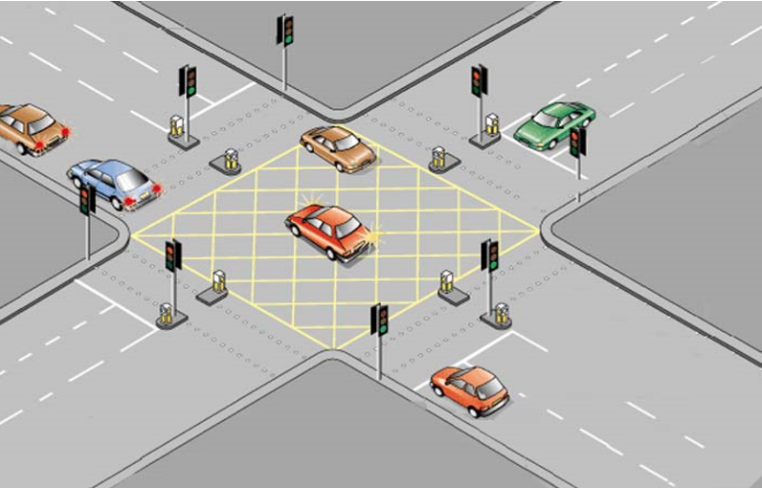
Study 4: Kanungo, A., Sharma, A., & Singla, C. proposed Smart traffic lights switching and traffic density calculation using video processing (2014)

Slide 16
Study 4: Kanungo, A., Sharma, A., & Singla, C. proposed Smart traffic lights switching and traffic density calculation using video processing (2014)
After Sunset or Low Light Conditions: Here the system doesn’t work up to the expectations due to lower light conditions, in that case we could switch over system to hard coded during night time.
This reduce traffic congestion on roads overriding the older system of hard coded lights which cause unwanted delays.

Slide 17
Literature Review
Name | Methodology | Advantage | Limits
Kanungo A, Sharma A & Singla C (2014) | Video Processing | improvement of about 35% above the Hard Coded system. | Ineffective during night hours
Khekare, G.S, Sakhare A.V.(2013) | VANET’s | Provide communication between vehicles themselves and between vehicles and road side | spontaneous and smart decisions on time would be slower
Badura S & Lieskovsky(2010) | MANET and Image Processing | provides support for pedestrian crossing and emergency vehicle passing | Ineffective during night hours
Haimeng Zhao, Xifeng Zheng, Weiya Liu (2009) | DSP and Nios II (using FPGA) | Works mostly at the mode of timing and multiple phases according to the user demands dynamically | Occurrence of Starvation in run time
Notes:
Case 2 is used for ambulance and long time traffic density

Slide 18
Summary
The method proposed by us overcomes the limitations of Khekare et.al (2014) as it is implemented on a junction and has no relation to every automobile that crosses it apart from its vehicle density and as the only hardware employed in our project would be the surveillance cameras at the junctions therefore no need of constant maintenance and less prone to failure as is the case with Salama et.al (2010) and Zhao et.al (2009).
Make efficient traffic signaling based on real time congestion data from google maps reducing the overall traffic congestion, this smart traffic avoidance system will reduce traffic and also reduce fuel consumption which will reduce pollution and overall carbon footprint.

Slide 19
Thank You

Slide 20
Reference
Kanungo, A., Sharma, A., & Singla, C. (2014). Smart traffic lights switching and traffic density calculation using video processing. 2014 Recent Advances in Engineering and Computational Sciences (RAECS).
Khekare, G. S., & Sakhare, A. V. (2013). A smart city framework for intelligent traffic system using VANET. 2013 International Mutli-Conference on Automation, Computing, Communication, Control and Compressed Sensing (iMac4s).
Badura, S., & Lieskovsky, A. (2010). Intelligent Traffic System: Cooperation of MANET and Image Processing. 2010 First International Conference on Integrated Intelligent Computing.
Zhao, H., Zheng, X., & Liu, W. (2009). Intelligent Traffic Control System Based on DSP and Nios II. 2009 International Asia Conference on Informatics in Control, Automation and Robotics

